Slide 1

February 2019
Inside Sherpa – Digital Internship
Technology, Strategy & Architecture – TS&I
Work in Progress Module Tasks and Ideal Responses
Deloitte Virtual Intern

Slide 2
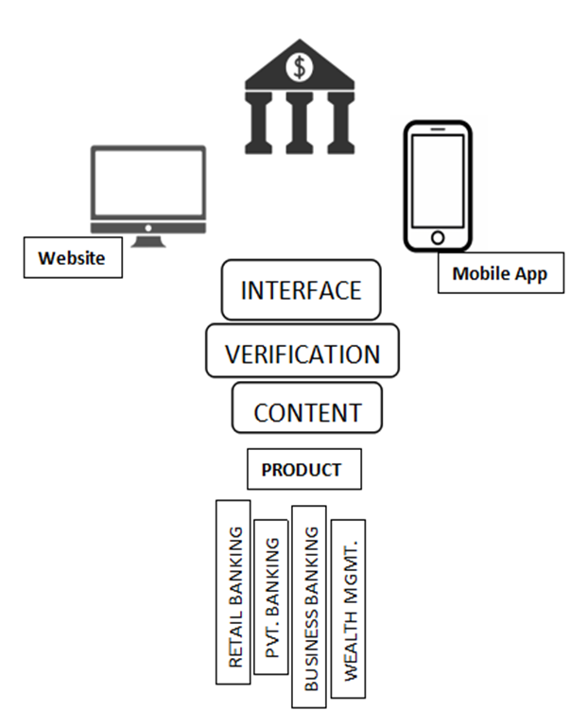
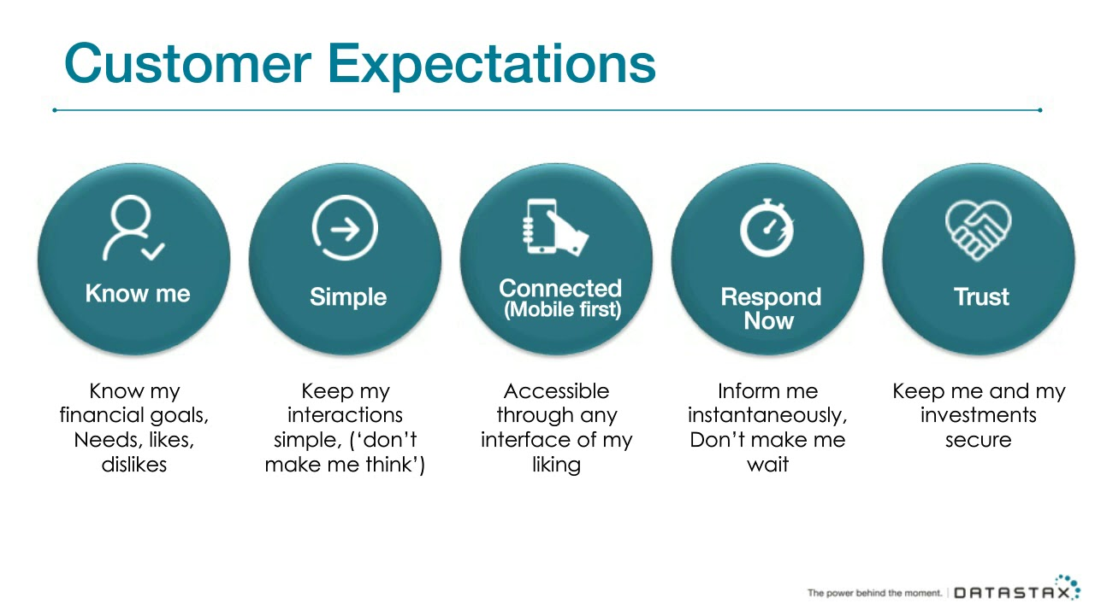
Client Discovery
Technology Architecture
Usability of the Solution

Slide 3
Client Discovery
Technology Delivery
Technology Framework and Compatibility
Cost – Effective
Security and authentication are key prioritizations
Strong database
Can alert and detect errors and avoid errors as well
Strong AI
Faster & Reliable
Automated
Branch Banking
Mobile Banking
ATM Channel of Banking
Mobile Banking or Phone Banking, Tele-Banking
Internet Banking, Online Banking, E-Banking

Slide 4
Business Case
Feasibility
Value Analysis
Things to consider:
Technical Feasibility
Economic Feasibility
Operational Feasibility
Legal Feasibility
Value Chain Analytics Tool (VCAT) supports Deloitte's approach to helping companies comprehensively review their value chain and begin to assess alignment with current transfer pricing arrangements. This innovative technology creates a context to begin pricing transactions between entities by assessing the relative contributions made by each entity to the overall business. Essentially comparing their impacts so we can get off on the right start when choosing a solution.

Slide 5
Business Case
Costs
Benefits
Single access point for all financial services ad products
Banking at customers own convenience, global and 24/7 client access to their info
Ensure better monitoring, data collection and analysis
Can create international competition $$$
Higher availability and better banking data

Slide 6
Considerations for Mobilization
Timeframes
Phase 1 : Nov 2020
Feasibility Analysis
UX design
Phase 2 : DEC 2020
Database infrastructure and design
Backend design and configuration
Phase 3 : JAN 2020
Database infrastructure and design
Backend design and configuration
Cost Estimates
Cost Estimation
Phase 1 | $10,000 - $14,000
Phase 2 | $25,000 - $27,000
Phase 3 | $7,000 – 10,000

Slide 7
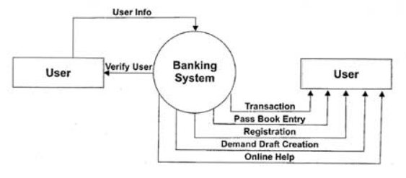
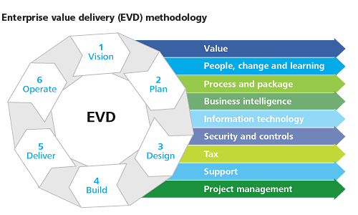
Considerations for Mobilization
Resource Requirements
Delivery Approach
Analyze which vendors will provide the best solutions for customer support and database needs. Better to use SaaS

